Slide 1
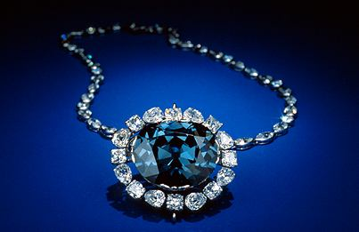
Facets of Creation Care

Slide 2
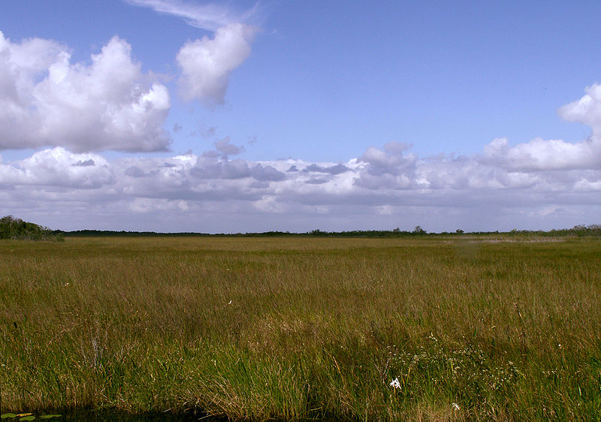
Everglades National Park:
Are the alligators real?
Are the baby alligators for sale?
Where are all the rides?
What time does the two o'clock bus leave?

Slide 3
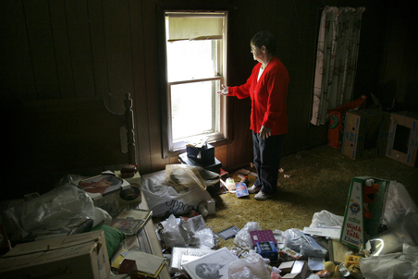
Nancy Sheppard looks though the broken window in the back of her Edison Neighborhood home, where burglars entered and ransacked her belongings. Her home has been burglarized several times and during the most recent, the invaders killed her dog by dousing the animal with household cleaners. (Julie Mack, Kalamazoo Gazette, May 17, 2009, 5:53AM)

Slide 4
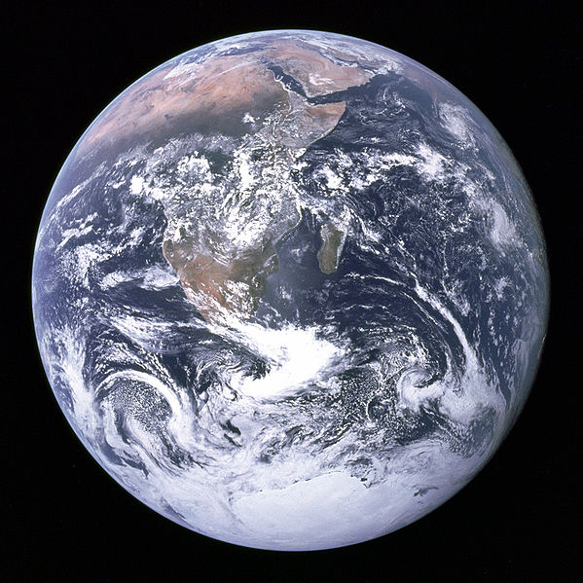
Who owns it?

Slide 5
How does God relate to the creation? God made the creation. It’s His.
Genesis 1:1-5 (NASB) In the beginning God created the heavens and the earth. [2] And the earth was formless and void, and darkness was over the surface of the deep; and the Spirit of God was moving over the surface of the waters. [3] Then God said, "Let there be light"; and there was light. [4] And God saw that the light was good; and God separated the light from the darkness. [5] And God called the light day, and the darkness He called night. And there was evening and there was morning, one day.
See also Ps 33; Neh 9:1-6; John 1:1-5; and many others.

Slide 6
God made the creation good… very good.
Genesis 1:1-5 (NASB) In the beginning God created the heavens and the earth. [2] And the earth was formless and void, and darkness was over the surface of the deep; and the Spirit of God was moving over the surface of the waters. [3] Then God said, "Let there be light"; and there was light. [4] And God saw that the light was good; and God separated the light from the darkness. [5] And God called the light day, and the darkness He called night. And there was evening and there was morning, one day.
Genesis 1:10, 12, 18, 21, 25
Genesis 1:31 (NASB) And God saw all that He had made, and behold, it was very good. And there was evening and there was morning, the sixth day.

Slide 7
God made the creation for Himself.
Col. 1:15-20 (NASB) And He is the image of the invisible God, the first-born of all creation. [16] For by Him all things were created, both in the heavens and on earth, visible and invisible, whether thrones or dominions or rulers or authorities-- all things have been created by Him and for Him. [17] And He is before all things, and in Him all things hold together. [18] He is also head of the body, the church; and He is the beginning, the first-born from the dead; so that He Himself might come to have first place in everything. [19] For it was the Father's good pleasure for all the fulness to dwell in Him, [20] and through Him to reconcile all things to Himself, having made peace through the blood of His cross; through Him, I say, whether things on earth or things in heaven.
See also Isa 42:1-8; Rom 11:33-36 and others.

Slide 8
God sustains the creation.
Psalm 104
Psalm 104:10-13 (NIV)
[10] He makes springs pour water into the ravines;
it flows between the mountains.
[11] They give water to all the beasts of the field;
the wild donkeys quench their thirst.
[12] The birds of the air nest by the waters;
they sing among the branches.
[13] He waters the mountains from his upper chambers;
the earth is satisfied by the fruit of his work.

Slide 9
God sustains the creation.
Psalm 104:27-30 (NIV)
These all look to you
to give them their food at the proper time.
[28] When you give it to them,
they gather it up;
when you open your hand,
they are satisfied with good things.
[29] When you hide your face,
they are terrified;
when you take away their breath,
they die and return to the dust.
[30] When you send your Spirit,
they are created,
and you renew the face of the earth.

Slide 10
The creation reveals God to us.
Romans 1:18-20 (NASB) For the wrath of God is revealed from heaven against all ungodliness and unrighteousness of men, who suppress the truth in unrighteousness, [19] because that which is known about God is evident within them; for God made it evident to them. [20] For since the creation of the world His invisible attributes, His eternal power and divine nature, have been clearly seen, being understood through what has been made, so that they are without excuse.
See also Ps 19:1-6 and others.

Slide 11
The creation reveals God to us.
“The first question which should rightly be asked,” wrote the great German philosopher and mathematician Gottfried Wilhelm Leibniz, “is: Why is there something rather than nothing?”… Unless we are prepared to believe that the Universe simply popped into existence uncaused out of nothing, then the answer must be: Something exists because there is an eternal, uncaused being from which no further explanation is possible.”
William Lane Craig, The Existence of God and the Beginning of the Universe

Slide 12
The creation reveals God to us.
“God can say, ‘Do you want to know something of what I am like? Look at the creation as I made it.’ The universe is not an extension of the essence of God, but in all its parts it does speak of Him.”
Francis Schaeffer, Genesis in Space and Time

Slide 13
The creation reveals God to us.
"What value has wildlife from the standpoint of morals and religion? I heard of a boy once who was brought up an atheist. He changed his mind when he saw that there were a hundred-odd species of warblers, each bedecked like to the rainbow, and each performing yearly sundry thousands of miles of migration about which scientists wrote wisely but did not understand. No 'fortuitous concourse of elements' working blindly through any number of millions of years could quite account for why warblers are so beautiful. No mechanistic theory, even bolstered by mutations, has ever quite accounted for the colors of the cerulean warbler, or the vespers of the wood thrush, or the swansong, or -- goose music.

Slide 14
The creation reveals God to us.
I dare say this boy's convictions would be harder to shake than those of many inductive theologians. There are yet many boys to be born who, like Isaiah, 'may see, and know, and consider, and understand together, that the hand of the Lord hath done this.' But where shall they see, and know, and consider? In museums?”
Aldo Leopold, Round River

Slide 15
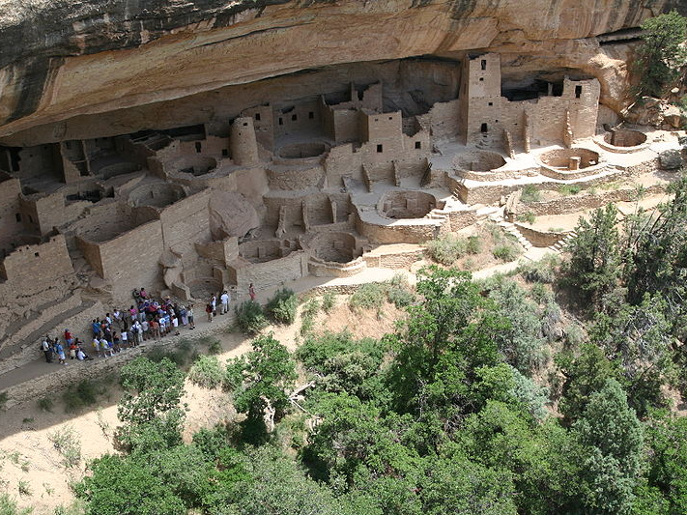
Mesa Verde National Park:
Why did the Indians decide to live in Colorado?
Why did they build the ruins so close to the road?
Do you know of any undiscovered ruins?
Did people build this, or did Indians?

Slide 16
What have we done to communities/ecosystems?
Examples of Ecosystem Loss in the U.S.: 1999 USGS survey:
Cut 95-98% of the virgin/old-growth forests in the lower 48 since 1620
98% of the tallgrass prairie
99% of California’s grasslands, 91% of its wetlands, and 85% of its redwood forests.
90% of Hawaii’s dry forests
81% of the nations fish communities
more than 50% of our wetlands.

Slide 17
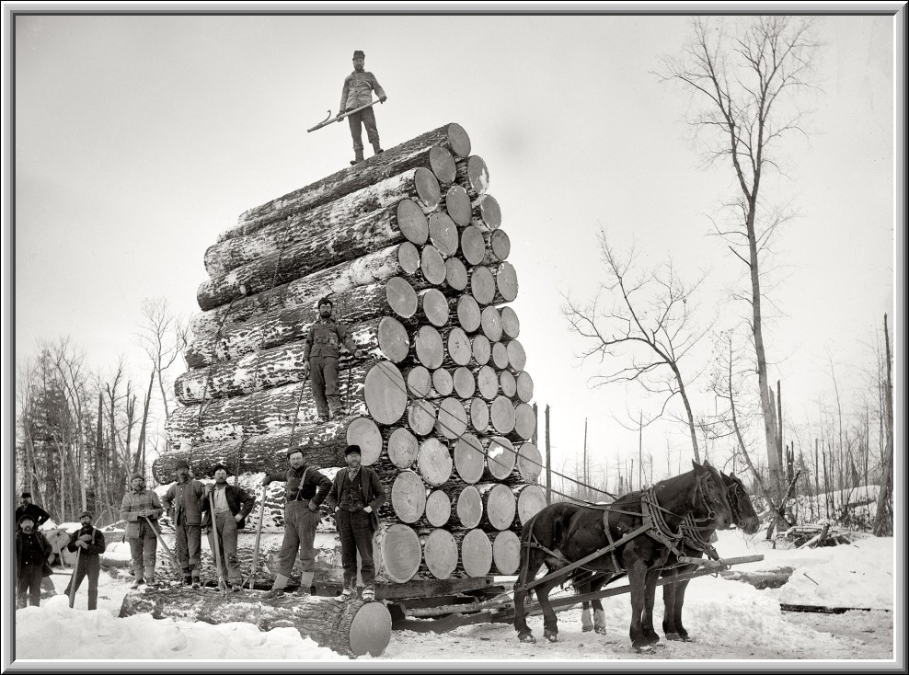
Pulling a big load in Ewen, Michigan 1893

Slide 18
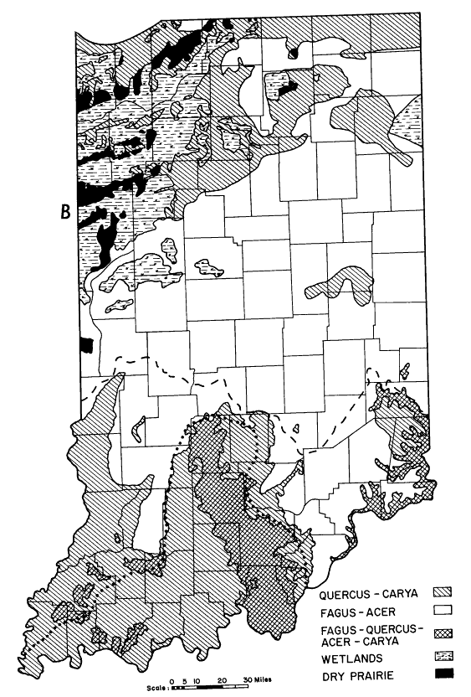
Plant Communities of Indiana
Dry | Grass | Prairie
 | Forest | Oak-Hickory
 |  | Mixed Mesophytic (Beech-Oak-Maple-Hickory)
 |  | Beech-Maple
Wet |  | Wetland
Lindsey, A. A., W. B. Crankshaw, and S. A. Qadir. 1965. Soil Relations and Distribution Map of the Vegetation of Presettlement Indiana. Botanical Gazette, 126(3): 155-163

Slide 19
Indiana State Seal

Slide 20
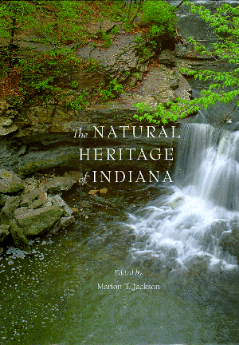
Plant Communities of Indiana
“Robert Ridgway, and eminent naturalist who studied and photographed the forests of the Lower Wabash River during the 1870s and 1880s, described the stands of timber of that region as ‘an exceedingly heavy virgin forest, some of the heaviest hardwood forest I have ever seen – as I have twice visited the Tropics (Central America) – covering almost the entire floodplain on the Indiana side.’”
Jackson, M. T. 2000. The Natural Heritage of Indiana. Indiana University Press, Bloomington.

Slide 21
Plant Communities of Indiana
“Ridgeway measured several sycamores at [8.0 to 9.5 feet in diameter] with overall heights of 160 to almost 200 feet. Several cypress stumps were measured in Knox County at 8 and 9 feet in diameter above their buttressed bases. He also measured a tuliptree, now rarely encountered on floodplains, that taped [8 feet in diameter], 91 feet to the first limb, and 190 feet total height. The maximum diameter he recorded for a tuliptree was 11 feet; the average diameter of 18 measured specimens was 6.2 feet. Heights ranged from 110 to 168 feet, averaging 143.5.
Ridgeway’s measurements were of felled trees, so we can be confident of his data.”

Slide 22
Plant Communities of Indiana
“Today, much less than 1 percent of the state remains in high-quality natural area. It is indeed sobering to realize that of the 20 million acres of original primeval forest that once occurred in Indiana – nearly enough to encircle the world one and a quarter times as a mile-wide band – today scarcely enough remains of high-quality old-growth forest in private ownership to encompass the Indianapolis Motor Speedway at the same one-mile width.”

Slide 23
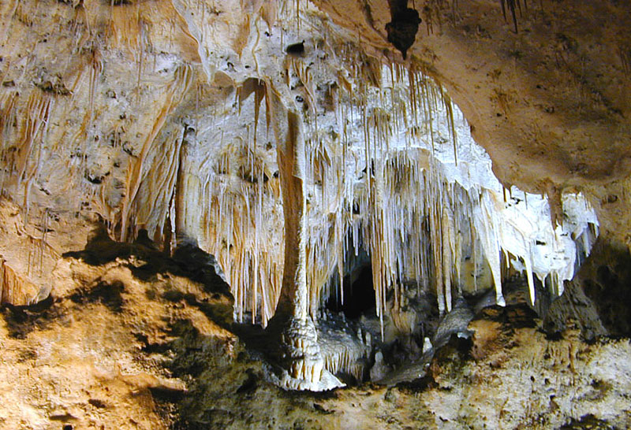
Carlsbad Caverns National Park:
How much of the cave is underground?
Does it ever rain in here?
How many Ping-Pong balls would it take to fill this up?
So what is this… just a hole in the ground?
So what's in the unexplored part of the cave?

Slide 24
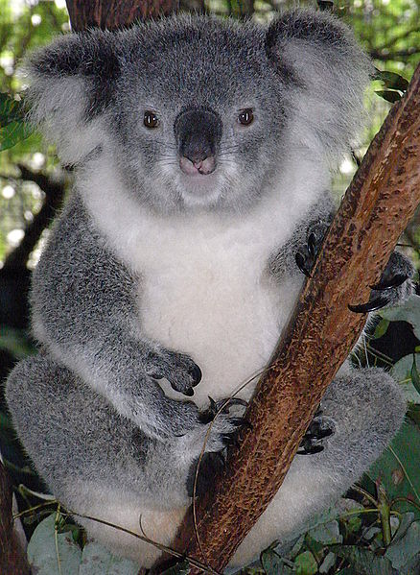
What have we done to species?
Psalm 104:24 (NIV) How many are your works, O LORD! In wisdom you made them all; the earth is full of your creatures.
…until now…

Slide 25
http://www.iucnredlist.org/

Slide 26
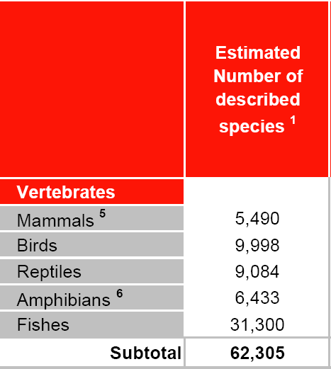
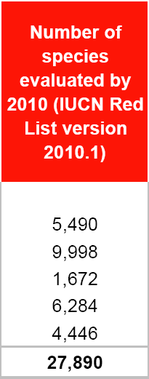
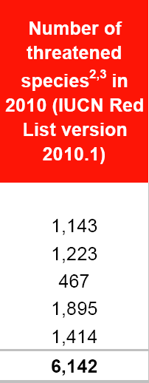
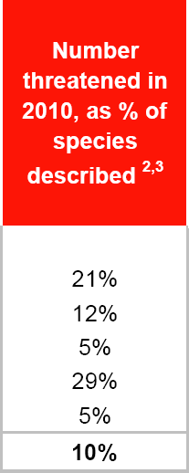
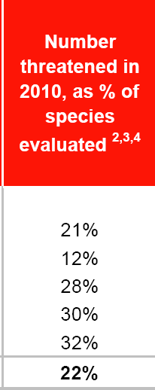
What have we done to the world’s vertebrates?
http://www.iucnredlist.org/documents/summarystatistics/2010_1RL_Stats_Table_1.pdf

Slide 27
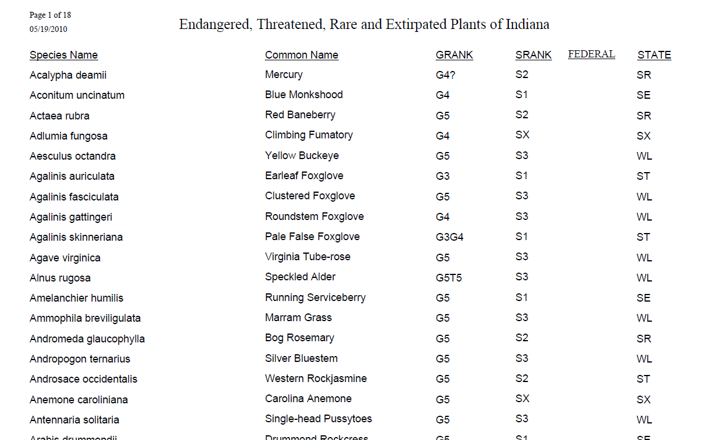
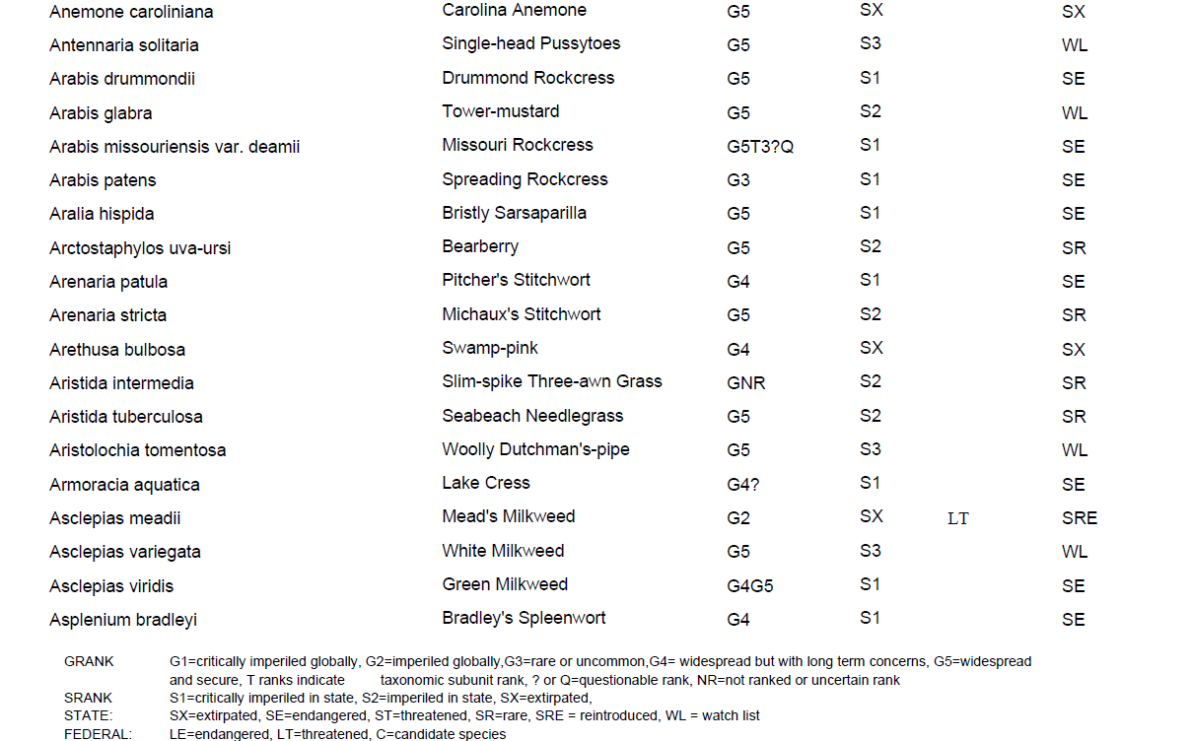
What have we done to plant species in Indiana?
35 species are listed on this page.
This is page 1 of 18.

Slide 28
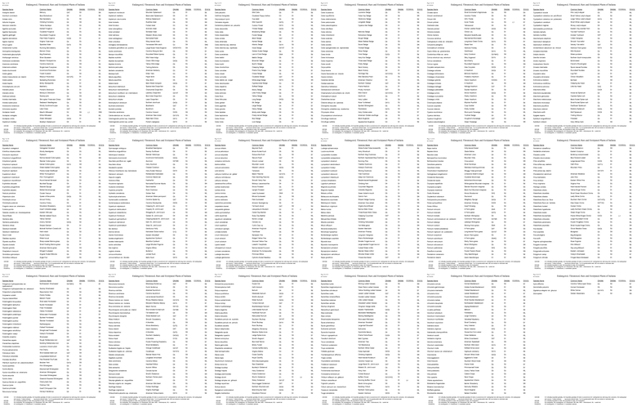
The complete list…

Slide 29
Endangered and Special Concern Animals of Indiana

Slide 30
Endangered and Special Concern Animals of Indiana

Slide 31
Endangered and Special Concern Animals of Indiana
These are just the groups that have been studied…

Slide 32
Extinct mammals of Indiana
“For millennia, thousands of these huge, shaggy beasts {bison} had periodically moved southeastward from the Illinois and western Indiana prairies, crossed the Wabash River near Vincennes, and stolidly sauntered along the famed Buffalo Trace … to the Falls of the Ohio at Louisville, on their journey to Big Bone Lick and the barrens of Kentucky to obtain minerals and salt.”
Jackson, M. T. 2000. The Natural Heritage of Indiana. Indiana University Press, Bloomington.

Slide 33
Extinct mammals of Indiana
“In densely wooded regions the bison were primarily transients, but in meadows and prairies they abounded. From the summit of a hill near Ouiatenon, a report of 1718 stated, ‘Noting is visible to the eye but prairies full of buffaloes.’”

Slide 34
Extinct mammals of Indiana
“But as prevalent as they once were, the bison were essentially wiped out in a score of years and were gone from the state by 1830. Elk, panther, black bear, fischer, and beaver disappeared with almost equal rapidity; all nearly gone from Indiana by 1850. Even the tenacious timber wolf, the white-tailed deer, and the bald eagle had been extirpated by the beginning of the twentieth century.”

Slide 35
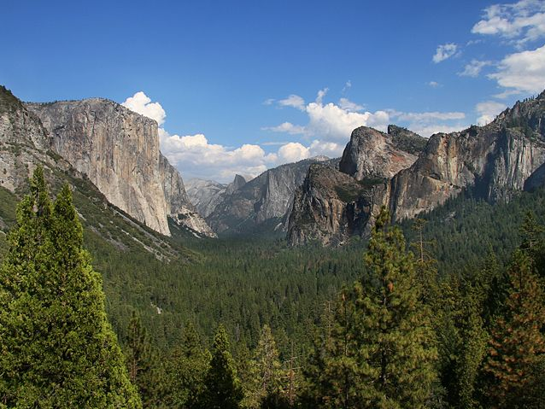
Yosemite National Park:
Where are the cages for the animals?
What time of year do you turn on Yosemite Falls?
What happened to the other half of Half Dome?
Can I get my picture taken with the carving of President Clinton?

Slide 36
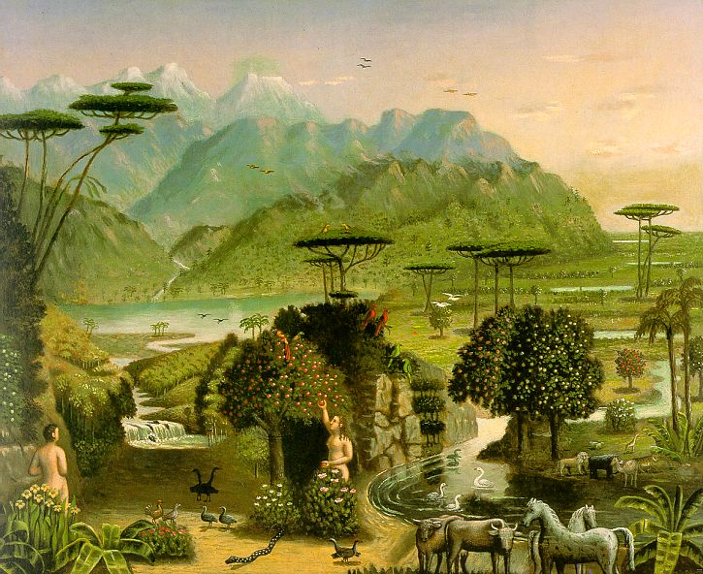
God made the creation good. Why don’t we care about the creation as God does?
Erastus Salisbury Field, The Garden of Eden, about 1860

Slide 37
We were made by God with right relationships.
Genesis 1:26-28 Then God said, "Let us make man in our image, in our likeness, and let them rule over the fish of the sea and the birds of the air, over the livestock, over all the earth, and over all the creatures that move along the ground."
²⁷ So God created man in his own image, in the image of God he created him; male and female he created them.
²⁸ God blessed them and said to them, "Be fruitful and increase in number; fill the earth and subdue it. Rule over the fish of the sea and the birds of the air and over every living creature that moves on the ground."

Slide 38
We were made by God with right relationships.
Genesis 2:7-9 the LORD God formed the man from the dust of the ground and breathed into his nostrils the breath of life, and the man became a living being. ⁸ Now the LORD God had planted a garden in the east, in Eden; and there he put the man he had formed. ⁹ And the LORD God made all kinds of trees grow out of the ground—trees that were pleasing to the eye and good for food. In the middle of the garden were the tree of life and the tree of the knowledge of good and evil.

Slide 39
We were made by God with right relationships.
Genesis 2:15-17 The LORD God took the man and put him in the Garden of Eden to work it and take care of it. ¹⁶ And the LORD God commanded the man, "You are free to eat from any tree in the garden; ¹⁷ but you must not eat from the tree of the knowledge of good and evil, for when you eat of it you will surely die."

Slide 40
We were made by God with right relationships.
Genesis 2:18-20a The LORD God said, "It is not good for the man to be alone. I will make a helper suitable for him."
¹⁹ Now the LORD God had formed out of the ground all the beasts of the field and all the birds of the air. He brought them to the man to see what he would name them; and whatever the man called each living creature, that was its name. ²⁰ So the man gave names to all the livestock, the birds of the air and all the beasts of the field.

Slide 41
We were made by God with right relationships.
Genesis 2:20b-22 But for Adam no suitable helper was found. ²¹ So the LORD God caused the man to fall into a deep sleep; and while he was sleeping, he took one of the man's ribs and closed up the place with flesh. ²² Then the LORD God made a woman from the rib he had taken out of the man, and he brought her to the man.

Slide 42
We were made by God with right relationships.
Genesis 2:23-25 The man said, "This is now bone of my bones and flesh of my flesh; she shall be called 'woman,' for she was taken out of man."
²⁴ For this reason a man will leave his father and mother and be united to his wife, and they will become one flesh.
²⁵ The man and his wife were both naked, and they felt no shame.

Slide 43
We were made by God with right relationships.
God
Man Self
Others
Creation Creation

Slide 44
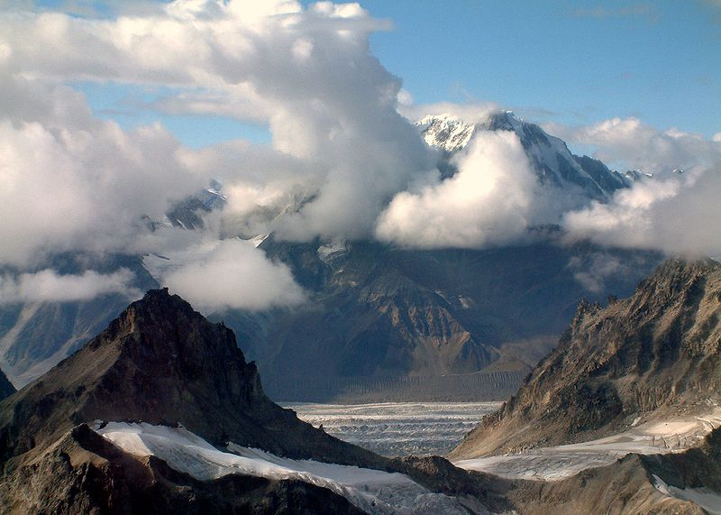
Denali National Park:
What time do you feed the bears?
What's so wonderful about Wonder Lake?
How often do you mow the tundra?
How much does Mount McKinley weigh?
Can you show me where yeti [the Abominable Snowman] lives?

Slide 45
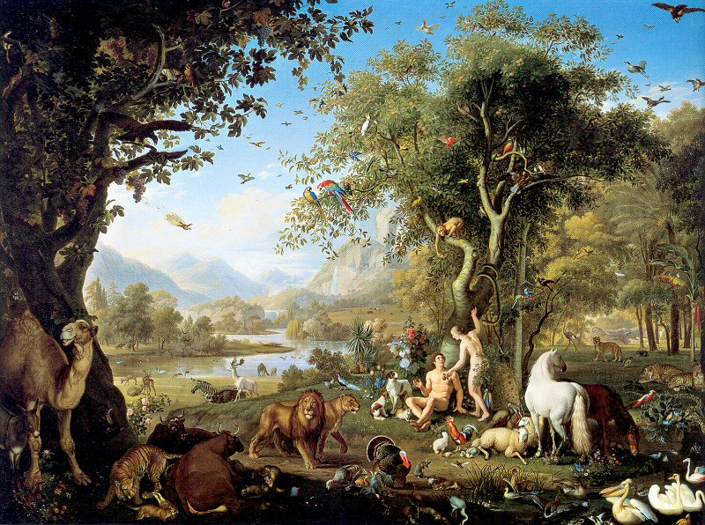
Sin Ruined Relationships If you want to understand why the world is the way that it is, then you need to understand Genesis 3.
Wenzel Peter, Adam and Eve in the Garden of Eden

Slide 46
Sin Ruined Relationships
Genesis 3:1-5 Now the serpent was more crafty than any of the wild animals the LORD God had made. He said to the woman, "Did God really say, 'You must not eat from any tree in the garden'?" ² The woman said to the serpent, "We may eat fruit from the trees in the garden, ³ but God did say, 'You must not eat fruit from the tree that is in the middle of the garden, and you must not touch it, or you will die.' "
⁴ "You will not surely die," the serpent said to the woman. ⁵ "For God knows that when you eat of it your eyes will be opened, and you will be like God, knowing good and evil.”

Slide 47
Sin Ruined Relationships
Genesis 3:6-7 ⁶ When the woman saw that the fruit of the tree was good for food and pleasing to the eye, and also desirable for gaining wisdom, she took some and ate it. She also gave some to her husband, who was with her, and he ate it. ⁷ Then the eyes of both of them were opened, and they realized they were naked; so they sewed fig leaves together and made coverings for themselves.

Slide 48
Sin Ruined Relationships
Genesis 3:8-12 Then the man and his wife heard the sound of the LORD God as he was walking in the garden in the cool of the day, and they hid from the LORD God among the trees of the garden. ⁹ But the LORD God called to the man, "Where are you?"
¹⁰ He answered, "I heard you in the garden, and I was afraid because I was naked; so I hid."
¹¹ And he said, "Who told you that you were naked? Have you eaten from the tree that I commanded you not to eat from?"
¹² The man said, "The woman you put here with me—she gave me some fruit from the tree, and I ate it

Slide 49
Sin Ruined Relationships
Genesis 3:13 Then the LORD God said to the woman, "What is this you have done?" The woman said, "The serpent deceived me, and I ate."

Slide 50
Sin Ruined Relationships
Genesis 3:14-15 So the LORD God said to the serpent, "Because you have done this, "Cursed are you above all the livestock and all the wild animals! You will crawl on your belly and you will eat dust all the days of your life.
¹⁵ And I will put enmity between you and the woman, and between your offspring and hers; he will crush your head, and you will strike his heel."

Slide 51
Sin Ruined Relationships
Genesis 3:16 To the woman he said, "I will greatly increase your pains in childbearing; with pain you will give birth to children. Your desire will be for your husband, and he will rule over you."

Slide 52
Sin Ruined Relationships
Genesis 3:17-19 To Adam he said, "Because you listened to your wife and ate from the tree about which I commanded you, 'You must not eat of it,' "Cursed is the ground because of you; through painful toil you will eat of it all the days of your life.
¹⁸ It will produce thorns and thistles for you, and you will eat the plants of the field.
¹⁹ By the sweat of your brow you will eat your food until you return to the ground, since from it you were taken; for dust you are and to dust you will return."

Slide 53
Sin Ruined Relationships
Genesis 3:20 Adam named his wife Eve, because she would become the mother of all the living.

Slide 54
Sin Ruined Relationships
Genesis 3:21-24 The LORD God made garments of skin for Adam and his wife and clothed them. ²² And the LORD God said, "The man has now become like one of us, knowing good and evil. He must not be allowed to reach out his hand and take also from the tree of life and eat, and live forever." ²³ So the LORD God banished him from the Garden of Eden to work the ground from which he had been taken. ²⁴ After he drove the man out, he placed on the east side of the Garden of Eden cherubim and a flaming sword flashing back and forth to guard the way to the tree of life.

Slide 55
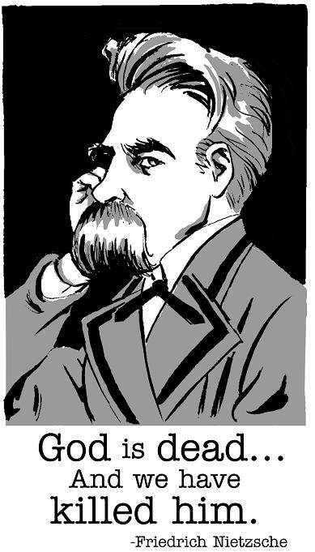
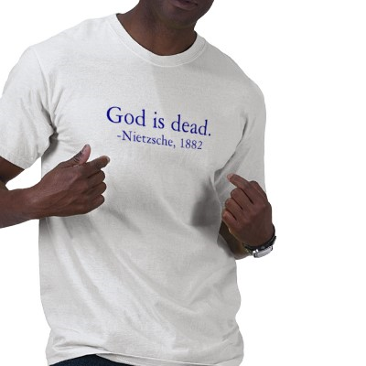
Sin ruined our relationship with God.
God
Man Self
Others
Creation Creation

Slide 56
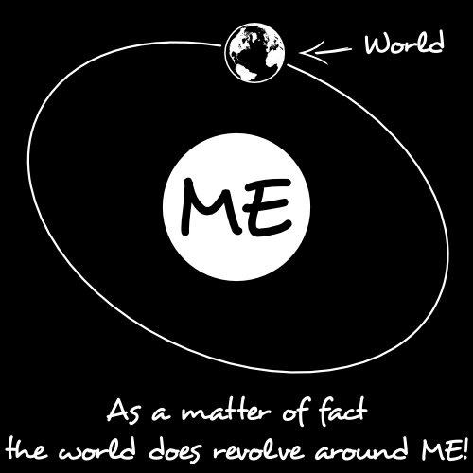
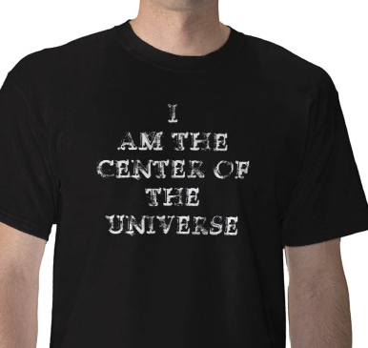
Sin ruined our relationship with ourselves.
God
Man Self
Others
Creation Creation

Slide 57
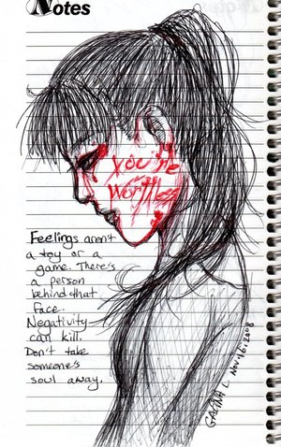
Sin ruined relationships between people.
God
Man Self
Others
Creation Creation

Slide 58
Sin ruined our relationship to the creation.
God
Man Self
Others
Creation Creation

Slide 59
Sin ruined the creation’s relationship to itself.
God
Man Self
Others
Creation Creation

Slide 60
Our Fall made us self centered.
"Humanity loses its harmony with the natural order and our God-given stewardship of the environment gives place to sinful plundering. This is manifest as exploitation, the needless destruction of the world without thought for its created beauty or intrinsic worth. It is also manifest as pollution, the selfish and rapacious use of raw materials, contaminating the oceans and the very atmosphere, all too often in the interests of economic profit, luxury and self-indulgence.“
Bruce Milne, Know the Truth

Slide 61
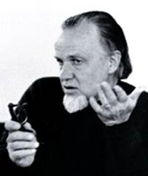
"...the hippies of the 1960s did understand something. They were right in fighting the plastic culture, and the church should have been fighting it too... More than this, they were right in the fact that the plastic culture - modern man, the mechanistic worldview in university textbooks and in practice, the total threat of the machine, the establishment technology, the bourgeois upper middle class - is poor in its sensitivity to nature... As a utopian group, the counterculture understands something very real, both as to the culture as a culture, but also as to the poverty of modern man's concept of nature and the way the machine is eating up nature on every side.”
Francis Schaeffer, Pollution and the Death of Man

Slide 62
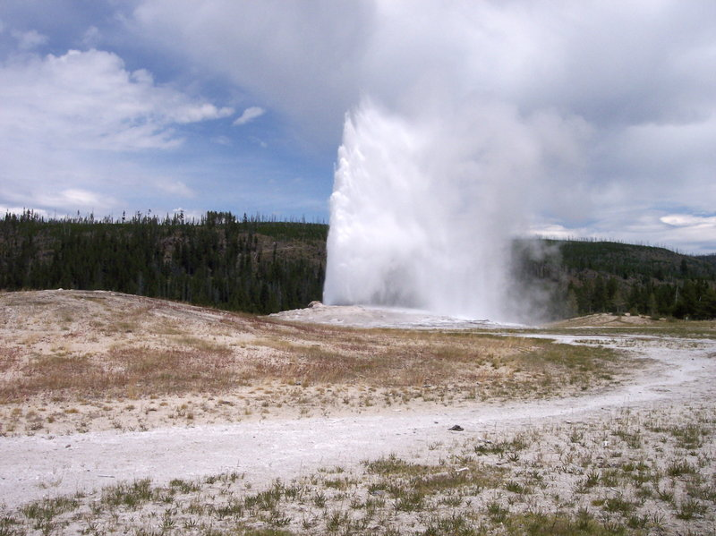
Yellowstone National Park:
Does Old Faithful erupt at night?
How do you turn it on?
When does the guy who turns it on get to sleep?
We had no trouble finding the park entrances, but where are the exits?

Slide 63
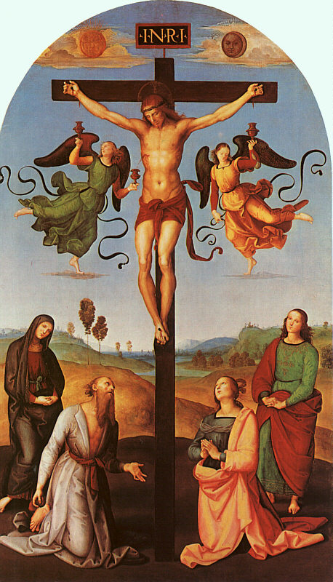
The Solution: Redeemed Relationships
Raphael, Christ on the Cross, 1502

Slide 64
Redeemed Relationships after the Cross
God
Man Self
Others
Creation Creation

Slide 65
Solutions?
There are many. A (very) few are:
It starts with our heart and attitude.
Know your ecological footprint.
Be aware that every one of our actions has consequences.
Get involved.
Read.
Learn.

Slide 66
"If God treats the tree like a tree, the machine like a machine, the man like a man, shouldn't I, as a fellow-creature, do the same - treating each thing in integrity in its own order? And for the highest reason: because I love God - I love the One who has made it! Loving the Lover who has made it, I have respect for the thing He has made.”
Francis Schaeffer, Pollution and the Death of Man

Slide 67
"The man who believes things are there only by chance cannot give things a real intrinsic value. But for the Christian, there is an intrinsic value. The value of a thing is not in itself autonomously, but because God made it. It deserves this respect as something which was created by God, as man himself has been created by God.”
Francis Schaeffer, Pollution and the Death of Man

Slide 68
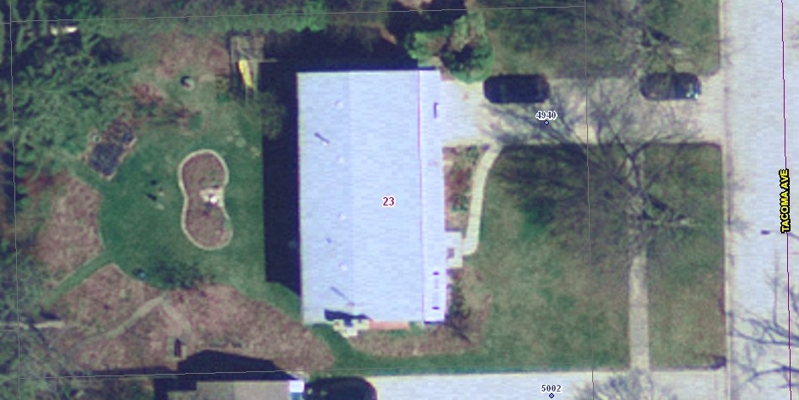
There are many solutions. One that I have done is to try to get rid of much of my grass and to replace it with native plants.
3-5
2
1

Slide 69
A list of birds that I have seen or heard in or from my yard:

Slide 70
Birds that I have seen or heard in or from my yard:
Great Blue Heron
Turkey Vulture
Canada Goose
Mallard
Cooper's Hawk
Red-tailed Hawk
Killdeer
Ring-billed Gull
Mourning Dove
Barred Owl
Common Nighthawk
Whip-poor-will
Chimney Swift
Ruby-throated Hummingbird
Belted Kingfisher
Red-bellied Woodpecker
Yellow-bellied Sapsucker
Downy Woodpecker
Hairy Woodpecker
Northern Flicker
Eastern Wood-Pewee
Great Crested Flycatcher
Blue Jay
American Crow
Carolina Chickadee
Tufted Titmouse
Red-breasted Nuthatch
White-breasted Nuthatch
Brown Creeper
Carolina Wren
House Wren
Golden-crowned Kinglet
Ruby-crowned Kinglet
Blue-gray Gnatcatcher
Swainson's Thrush
American Robin
European Starling
Gray Catbird Northern Mockingbird Brown Thrasher
Cedar Waxwing
Blue-winged Warbler
Nashville Warbler
Yellow Warbler
Magnolia Warbler
Black-throated Blue Warbler
Yellow-rumped Warbler
Blackburnian Warbler
Black-and-White Warbler
American Redstart
Common Yellowthroat
Wilson's Warbler
Eastern Towhee
Chipping Sparrow
Song Sparrow
White-throated Sparrow
White-crowned Sparrow
Dark-eyed Junco
Northern Cardinal
Rose-breasted Grosbeak
Indigo Bunting
Red-winged Blackbird
Common Grackle
Brown-headed Cowbird ☹
House Finch
American Goldfinch
House Sparrow ☹
66 species so far…

Slide 71
Native Plant Gardening
Grow Native!
National Wildflower Research Center
Sustainable Urban Landscape Information Series
United States Environmental Protection Agency, Green Acres_ Green Landscaping with Native Plants
Prairie Nursery: Clay Busters & Plants for Medium Soils
Indiana Native Plant and Wildflower Society (INPAWS)
INPAWS – Landscaping with Plants Native to Indiana
INPAWS – Landscaping with Plants Native to Indiana - Photos

Slide 72
Summary
God made the creation good.
We rebelled against God in the Fall.
Our sin makes us self-centered.
Christ came to redeem all of creation from the effects of the fall.
Our job is to do His work until He returns to make it right again.
Part of that work is to renew our relationship with God’s creation.
What can you do?
What will you do?

